Slide 1
Automatic Shader Simplification using Surface Signal Approximation

Slide 2
The Idea:
Fragment/pixel shader often the bottleneck.
Since screen resolution are getting bigger and bigger.
And since shaders are getting more complex.
Doing calculations in vertex shader often results in unacceptable quality
So simplify the fragment shader!
Notes:
The fragment shader is often the bottleneck. This is because because the fragment often has to be evaluted a lot more than the other shader stages. Look at this sphere for instance: its front facing polygons are x, so the vertex shader is run x times.
But yet the pixels occupied by this sphere are approx y, which is a lot more.
So the point is that with the high screen resolutions of todays display, the fragment shader tends to be executed a lot more!
Another point is that the fragment shader often has to do a lot more than the vertex shader. Advanced and expensive lighting models tend to be evaluted entirely in the fragment shader. (show imrod image).

Slide 3
Three transformation rules
Rule 1: move fragment shader code to a previous shader stage.
Rule 2: approximate patterns formed by shader with bezier triangle interpolation.
Rule 3: Tesselate and apply rule 1 or rule 2

Slide 4
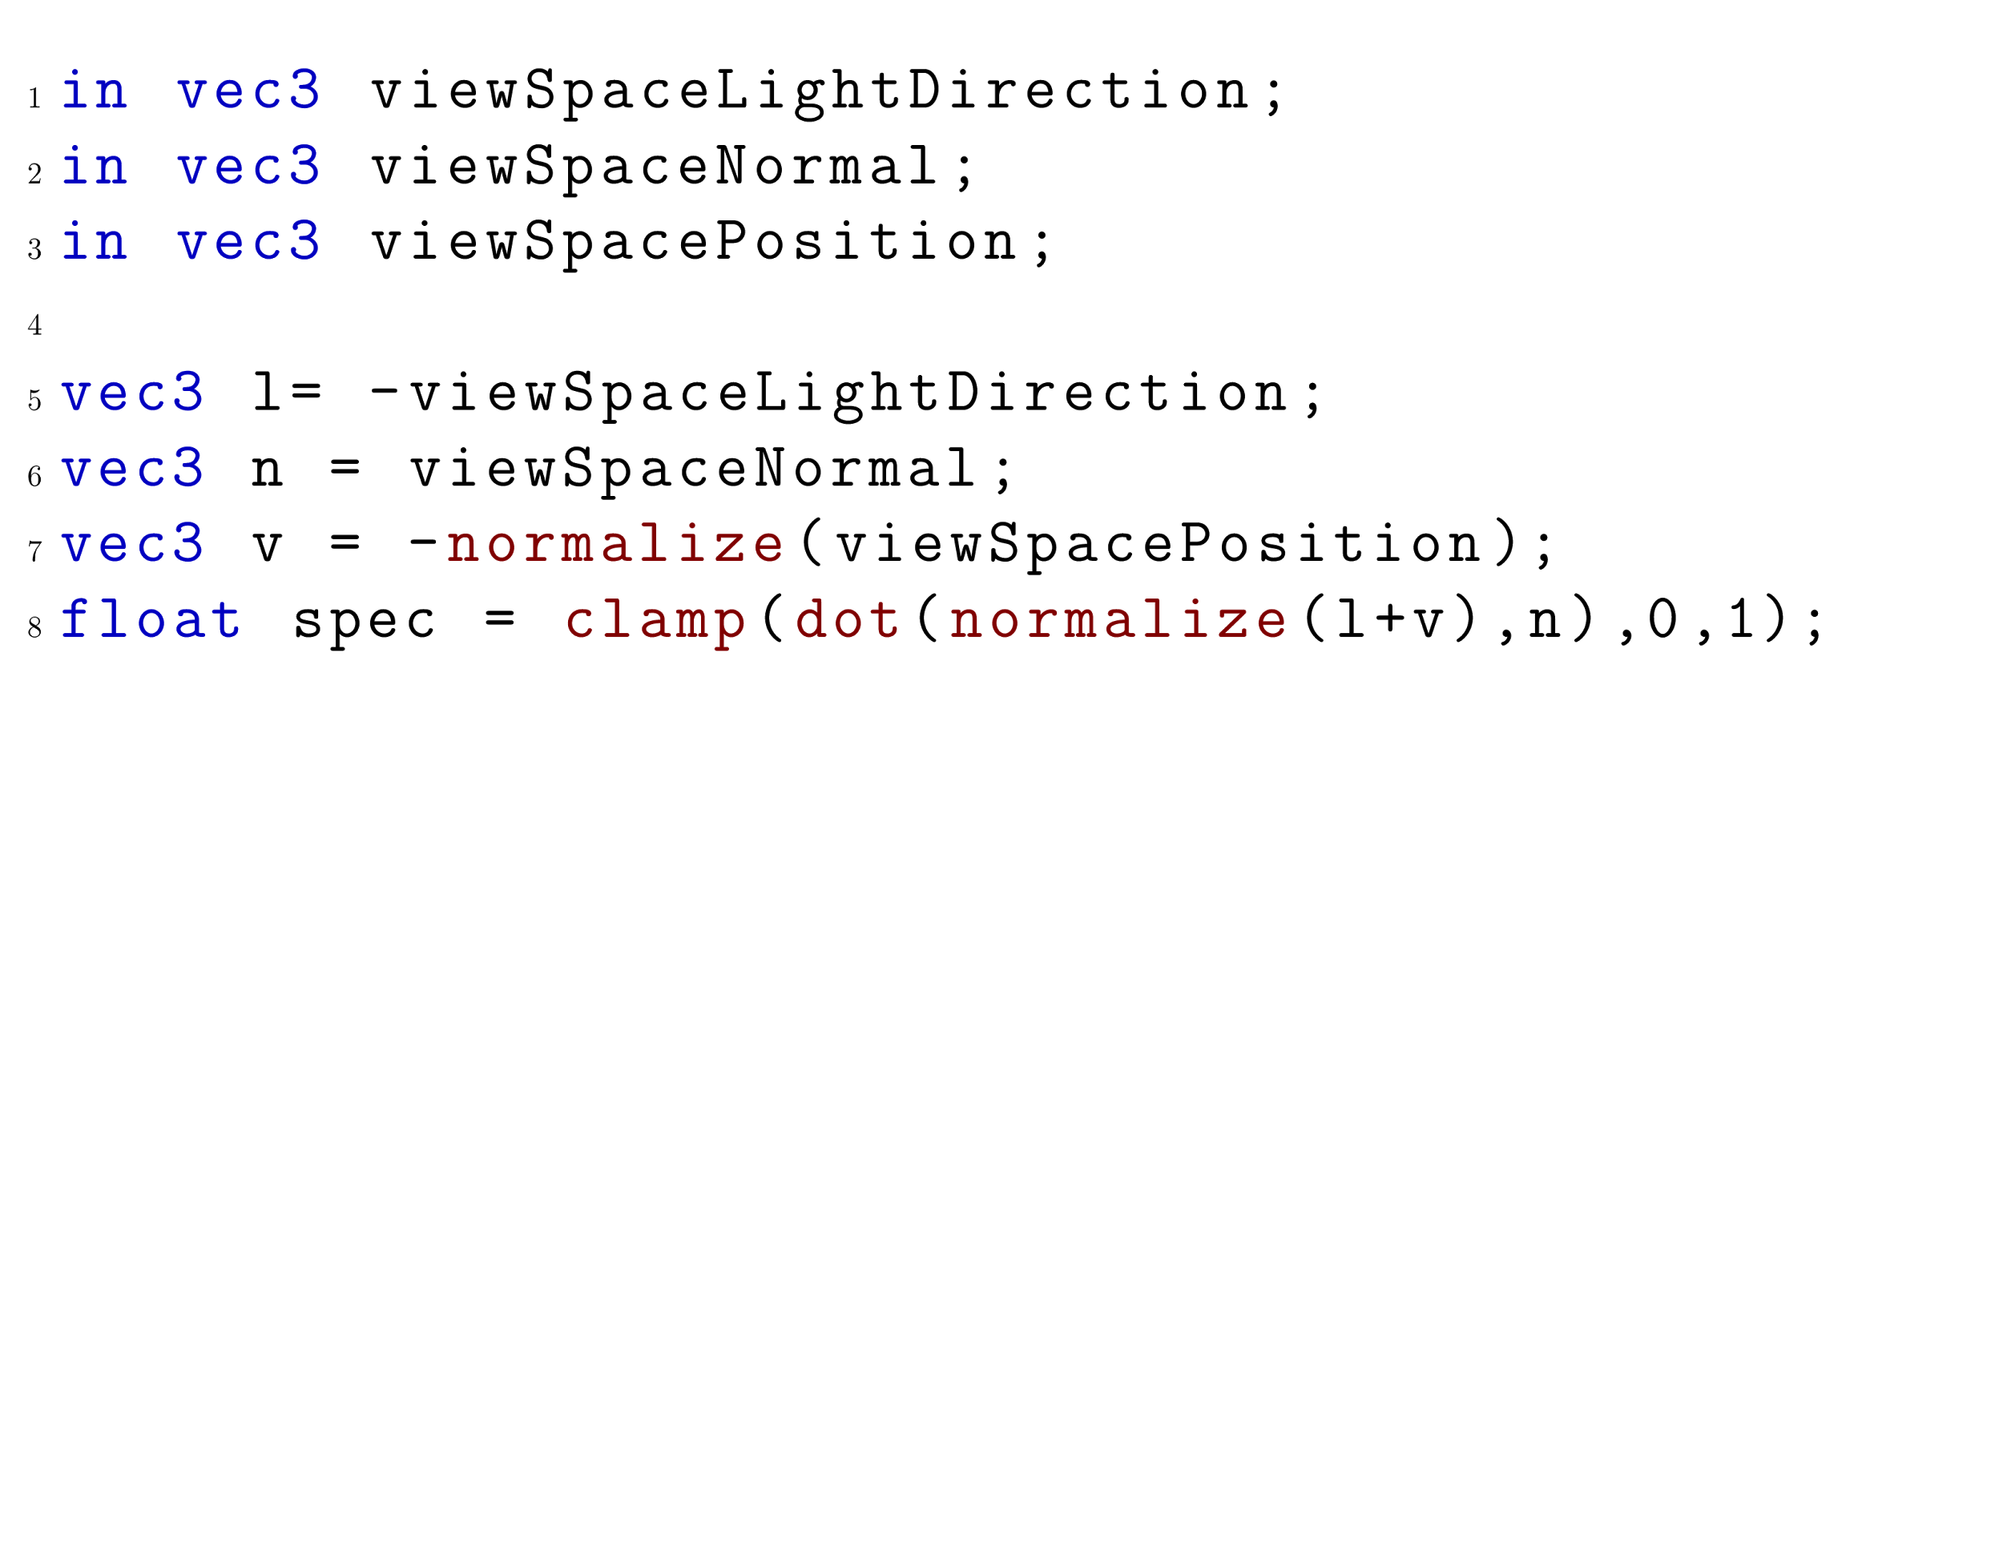
Shader slice
A shader slice with respect to a variable x and line n, consists of line n and all statements that might affect the value of x at line n.
Notes:
But before I can start discussing the algo, first I need to discuss some theory.
First I define a shader slice. A shader slice is defined with respect to some variable x and a line n. The shader slice with respect to line 5 and variable diffuse, is all of line 1-5. Because these lines in some manner or another affect the value of the variable diffuse at the point line 5 in the program.

Slide 5
Rule 1: Code Transformation
Move a shader slice from the fragment shader stage to some earlier stage( vertex/geometry/domain shader).
Notes:
The shader simplification algo in this paper, simplifies shaders by applying three different simplification rules to the shader. Let us go through the first transform, the simplest.
In this rule, a shader slice is moved from the fragment shader stage to some earlier shader stage. For example, say I want to move this phong calculation out of the fragment shader to the vertex shader. Then I take all this code(line 1-5), compute it at the end of the vertex shader, and send it to the fragment shader.
Note that I simply cannot move this “float diffuse” to the vertex shader, because it depends on the previous lines. that is why we had to carefully define a shader slice. so that we do not end up with invalid shaders.

Slide 6
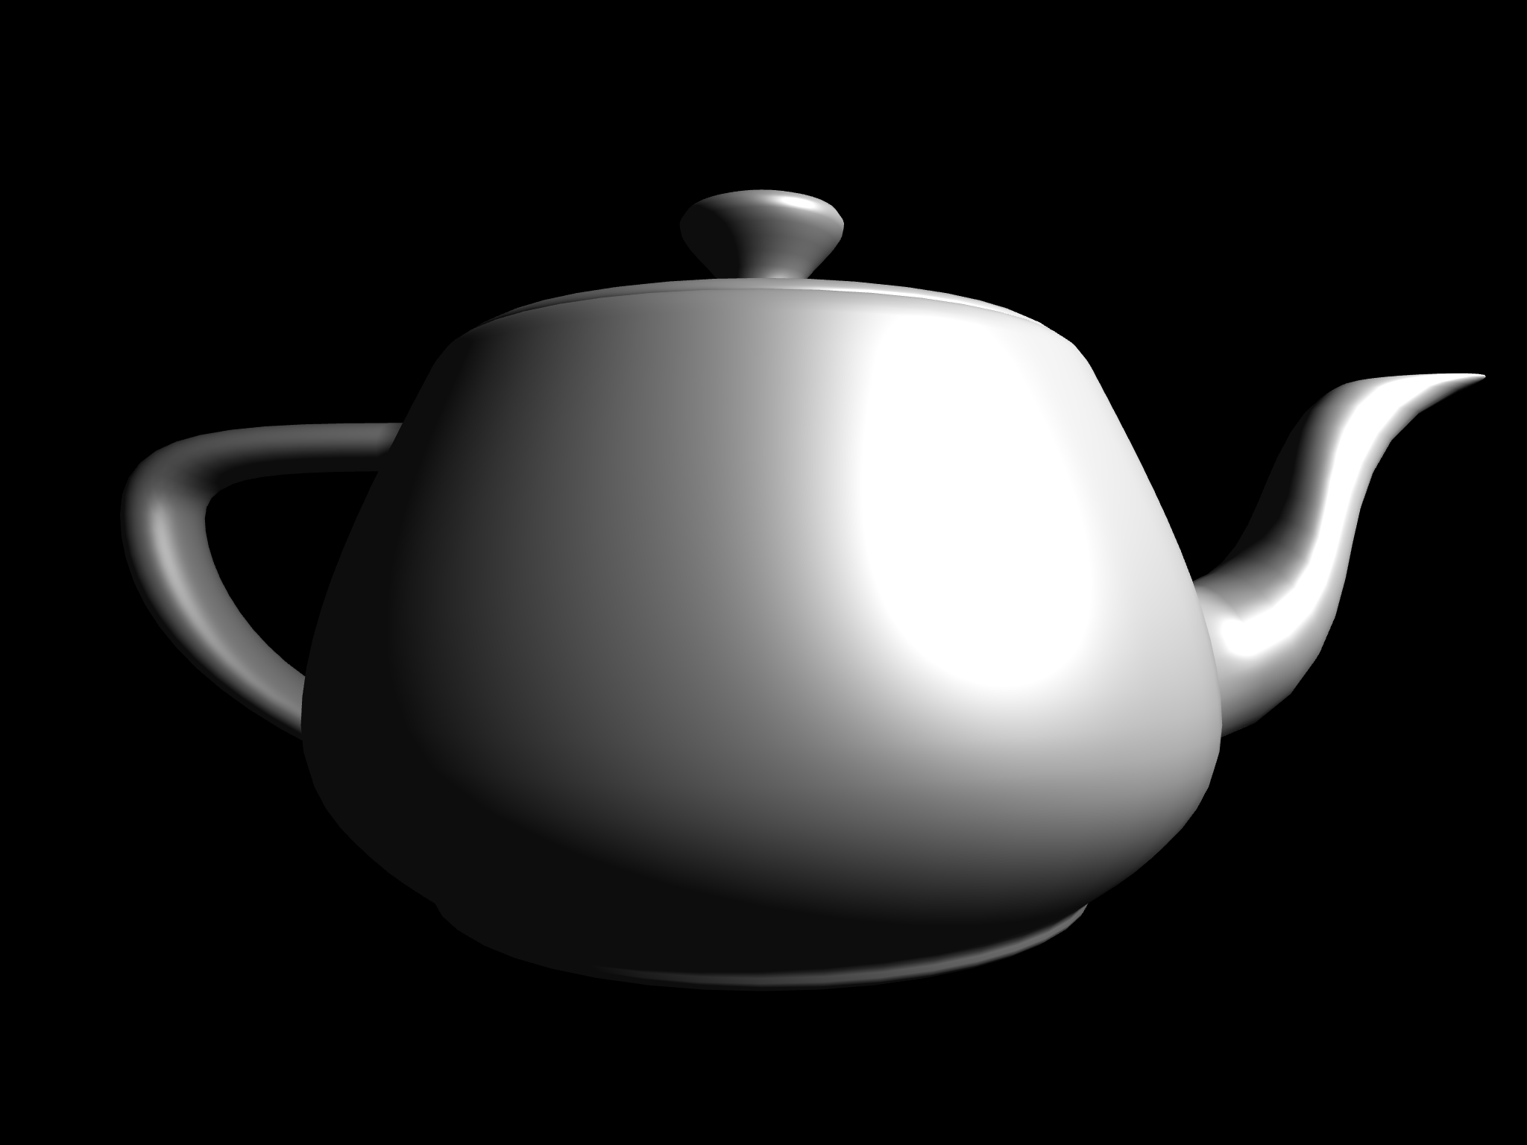

Slide 7
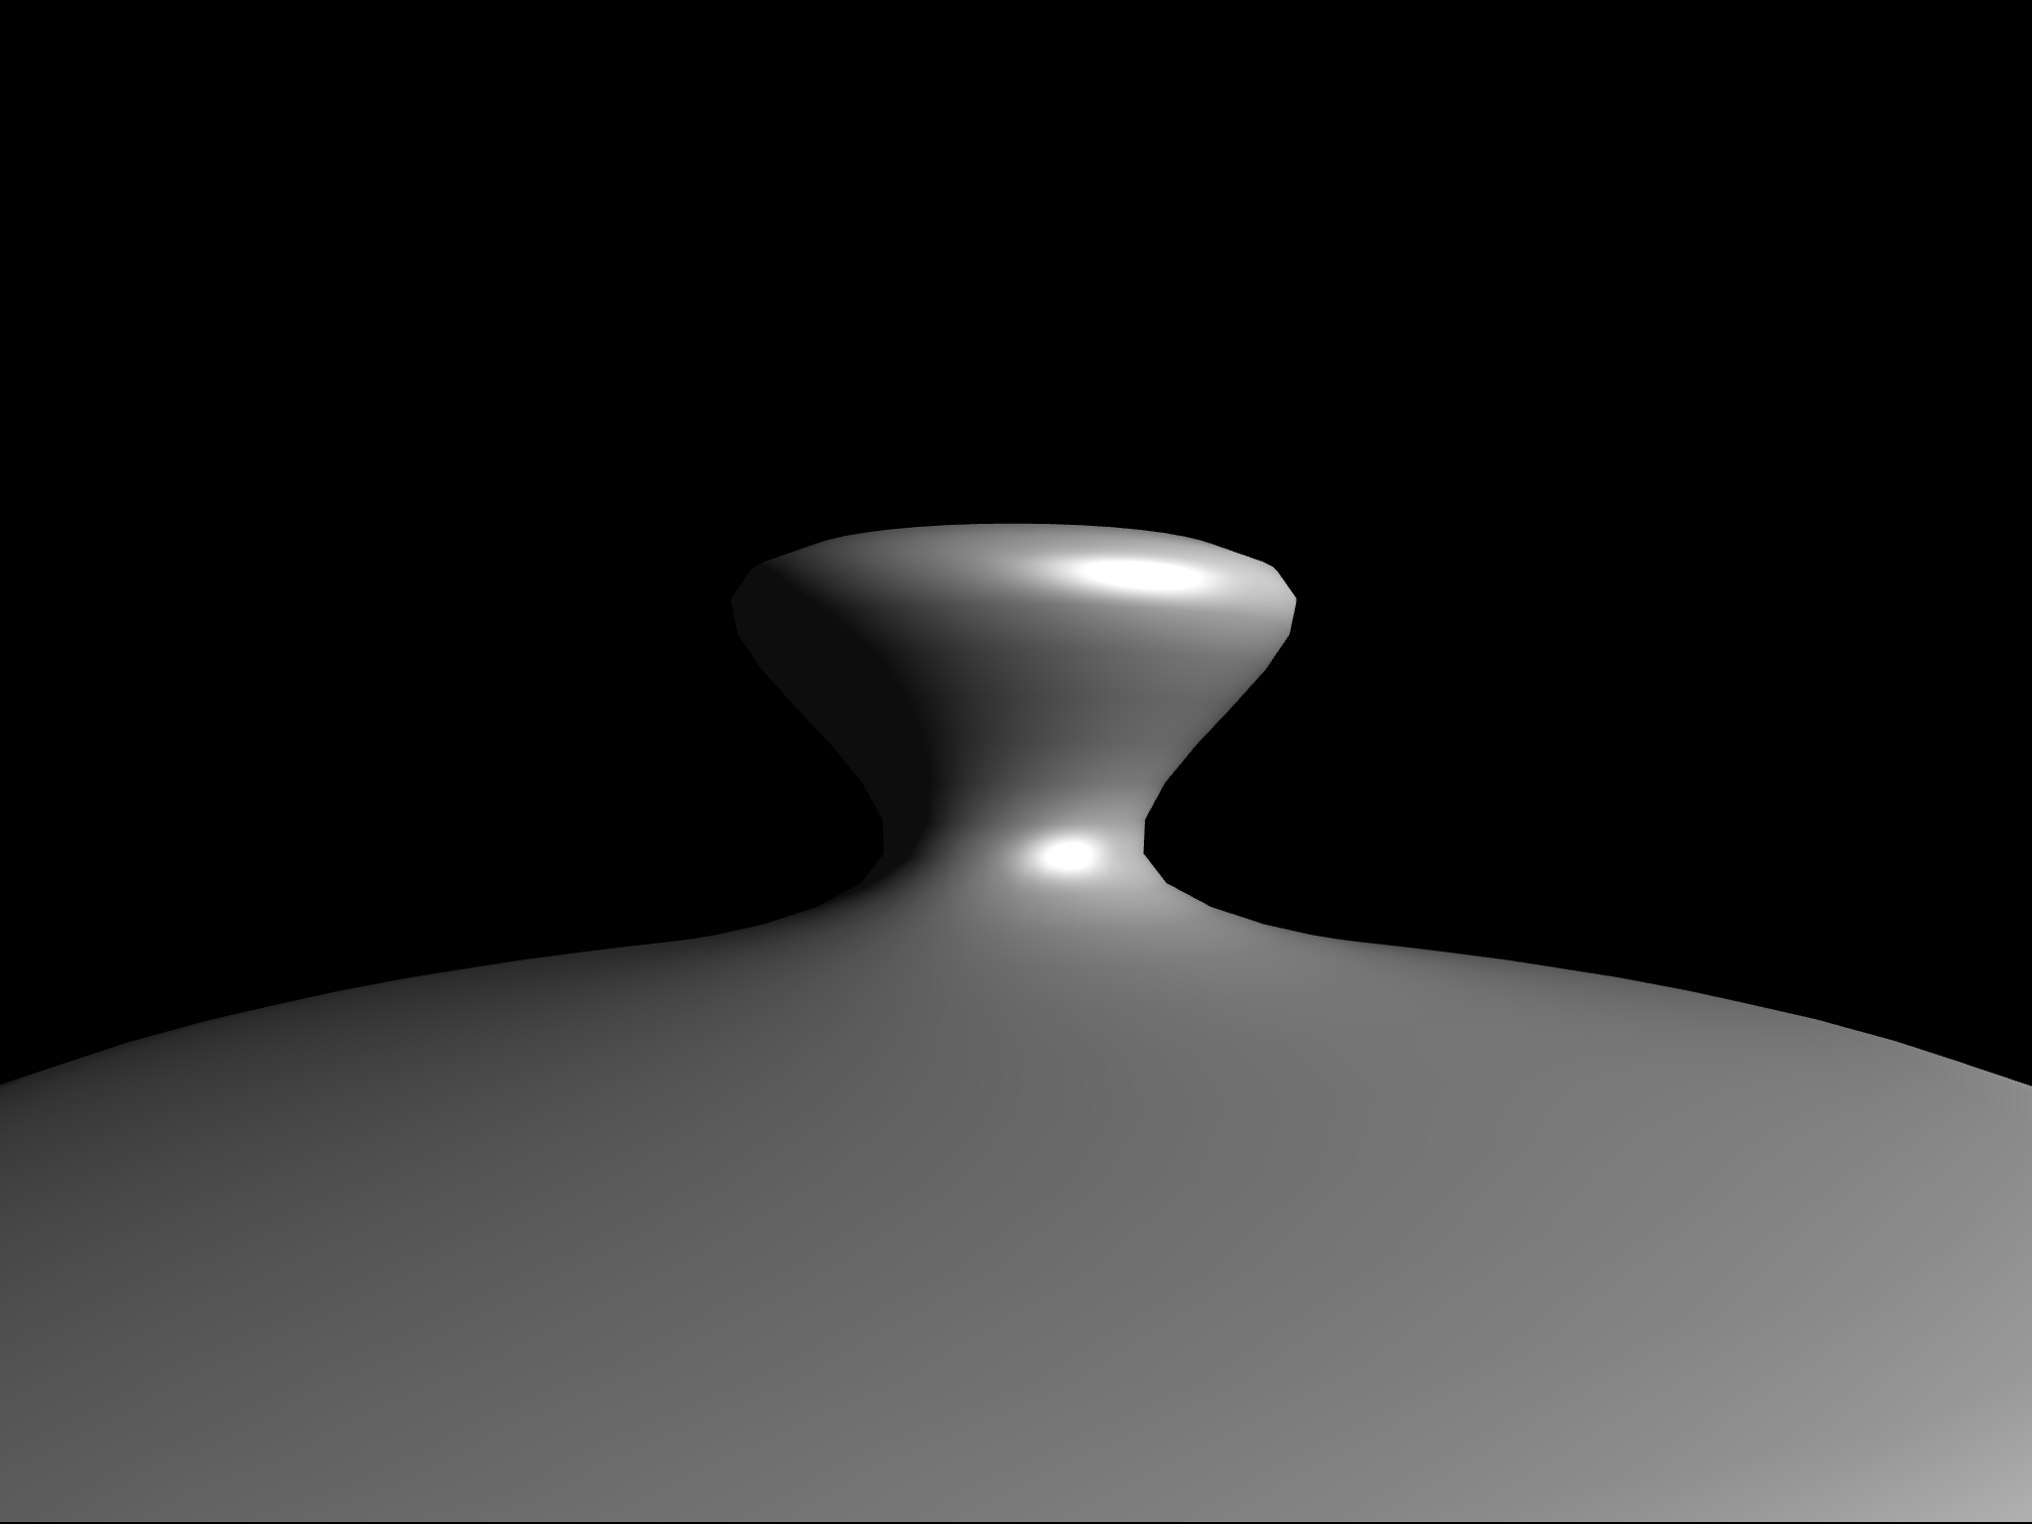
Phong(per fragment)
Gouraud(per vertex)

Slide 8
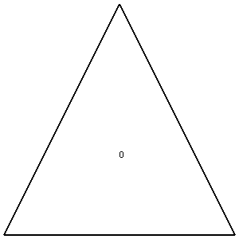
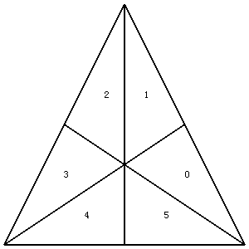
Rule 3: Subdivide surface
Tesselate every triangle of original mesh at runtime.
Tesslate
Notes:
Because rule 1 is often combined with rule 3, subdivide surface.
What this rule does, is that tesselates all the triangles that are sent to the shader at runtime. So, without modifying the original mesh, the tesselation shader can be used to subdivide triangles into smaller triangles at runtime.
What will happen is that every triangle will be tesslated to one of these three tesselation levels, creating lots new geometry at runtime.
Note that this rule 3 can only be used once. We can’t have that two triangles have different tesslation levels.
And after this rule 3 has been applied, usually what happens is that either rule 1 or 2 is applied.

Slide 9
Rule 1 and 3 combined
Move shader slice from fragment shader to domain shader.
Notes:
Let us see what happens when rule 1 is applied after rule 3.
We can use rule 3 to improve the Gouraud shading that resultet from rule 1. because now that rule 3 has been applied, lots of new vertices have been created in the triangle.
Now, instead of computing the phong lighting very these three vertices in the vertex shader, instead we compute the phong lighting for all these newly created vertices. But these vertices cannot be accessed in the vertex shader, because the tesselation shader is run AFTER the vertex shader in the pipeline. Instead, there is a shader called the domain shader, and every created tessselated vertex is passed through this shader.
Thus, we move the phong calculation from the fragment shader, to the domain shader. And this greatly improves the visual appearance, while at the same time saving lots of computations:

Slide 10
Notes:
original

Slide 11
Notes:
tess_level 2

Slide 12
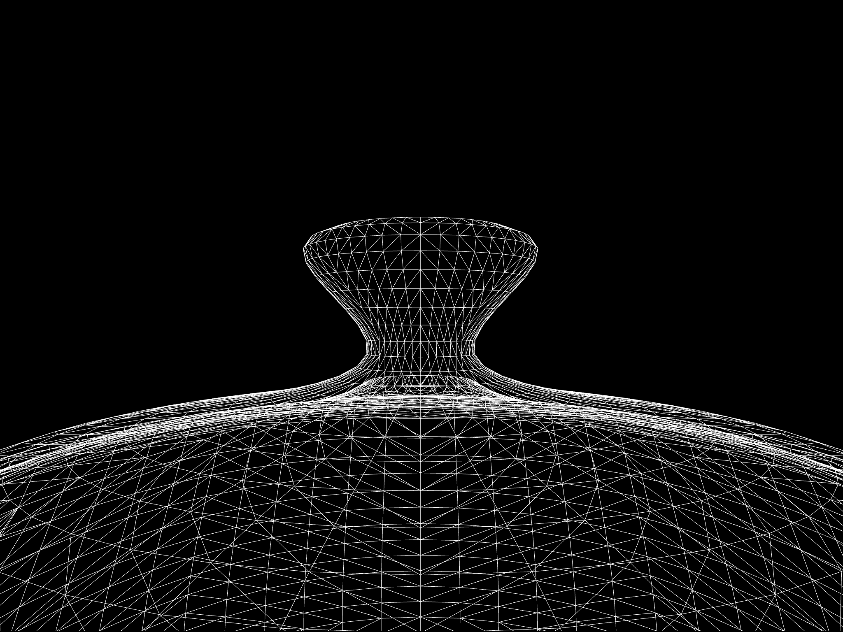
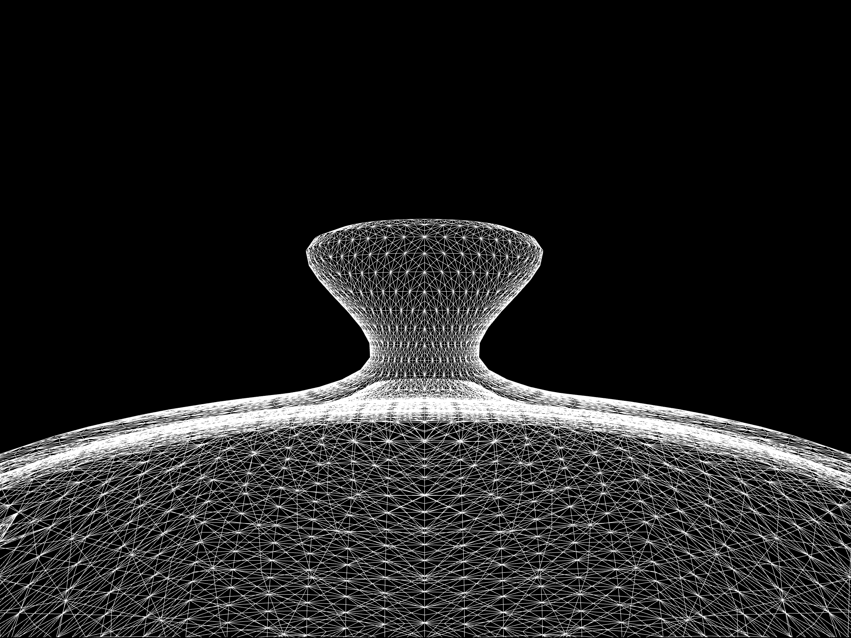
tess1 tess2

Slide 13
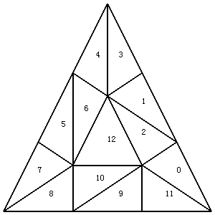
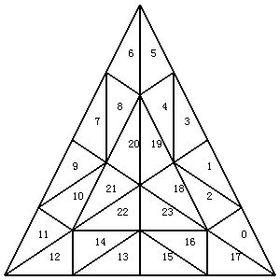
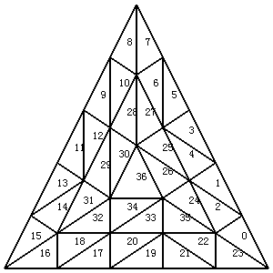
Tesselation level
1
2
3
4
5

Slide 14
tess3

Slide 15
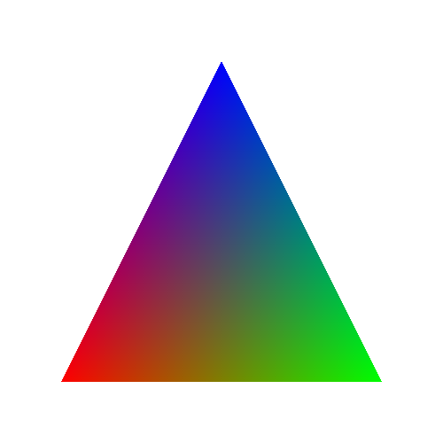
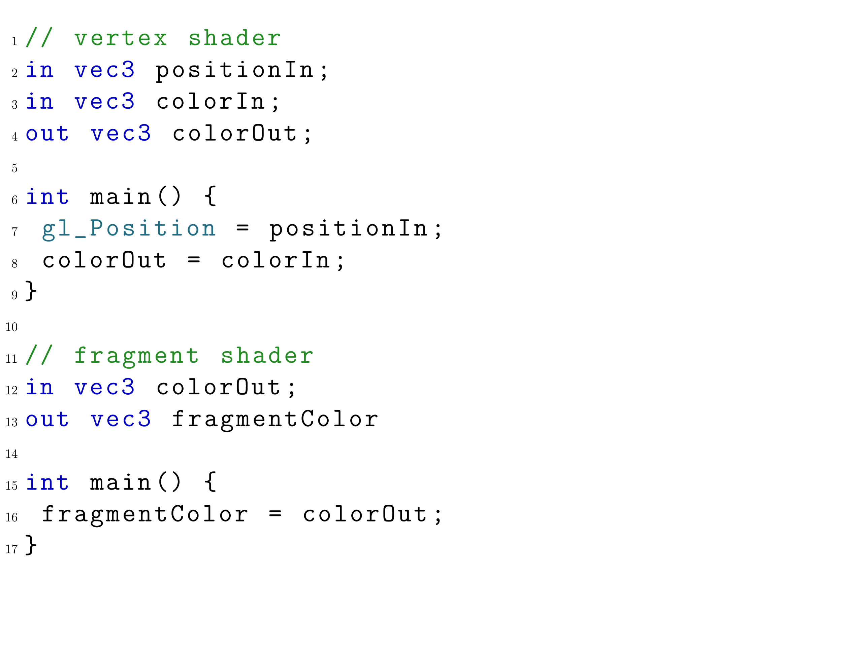
Rule 2: approximating shader slice on the surface
Notes:
Now let us get to rule 2, the most difficult and abstract of all the rules.

Slide 16
Barycentric coordinates
(0,1)
Specifies the nearness of the three triangle vertices
Sometimes specified as (u,v,w). But since always u+v+w=1, w is redundant.
So we use (s,t), where the third one 1-s-t
(0.5,0.5)
(0,0.5)
(⅓,⅓ )
(1,0)
(0,0)
(0.5,0)

Slide 17
(0,1)
All vertex interpolation is done with barycentric coordinates.
The color of a fragment is s*r + t*b + (1-s-t)*g
(1,0)
(0,0)

Slide 18
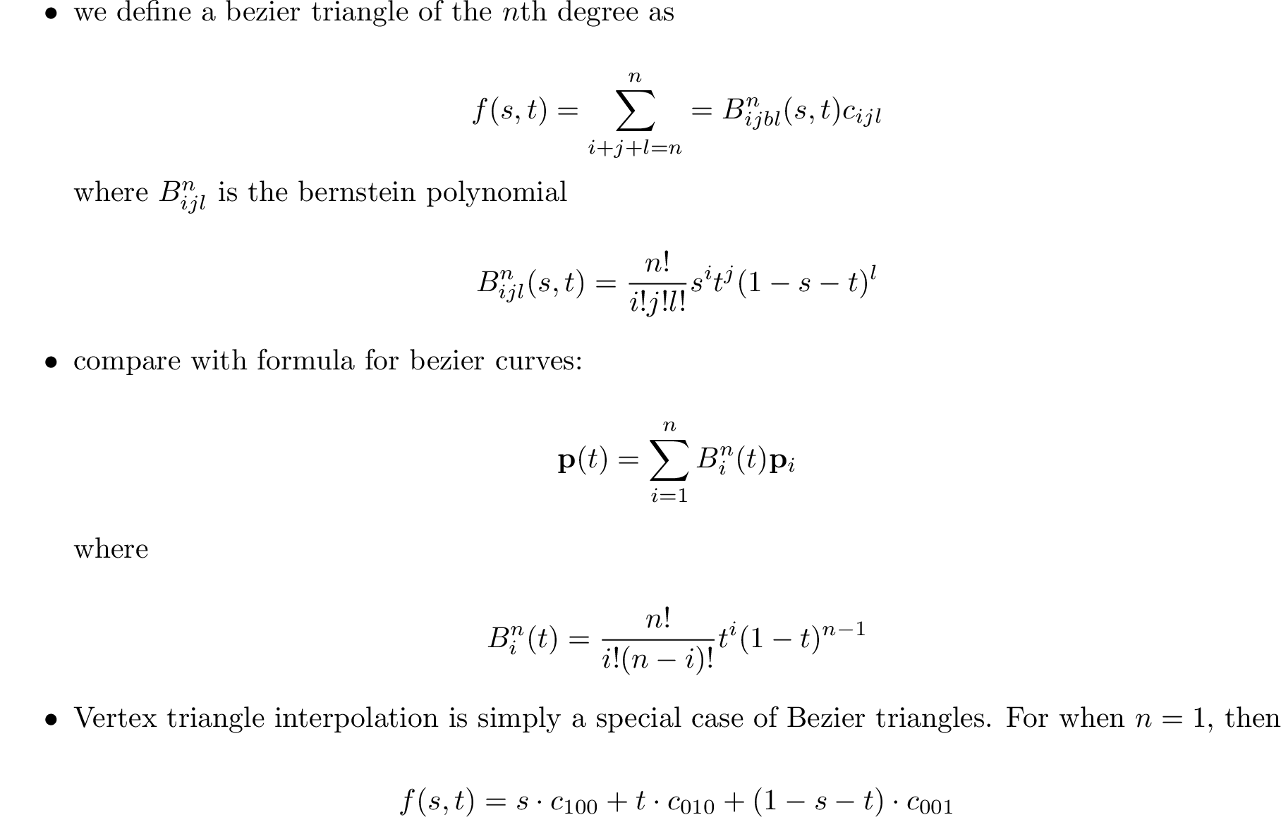

Slide 19
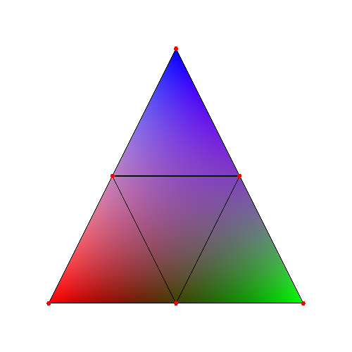
Second degree bezier triangle
We get three more control points to play with
We can specify more advanced patterns
A compact way of specifying color patterns
Formula is

Slide 20
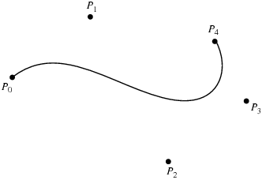
Nice and compact

Slide 21
The Idea:
Shader slices result in color patterns being formed on the triangle fragments.
Bezier triangles can be used to compactly specify color patterns, by assigning colors to control points
So, instead of doing the shader slice calculation, simply specify the pattern created by the shader slice by using bezier triangles!!

Slide 22
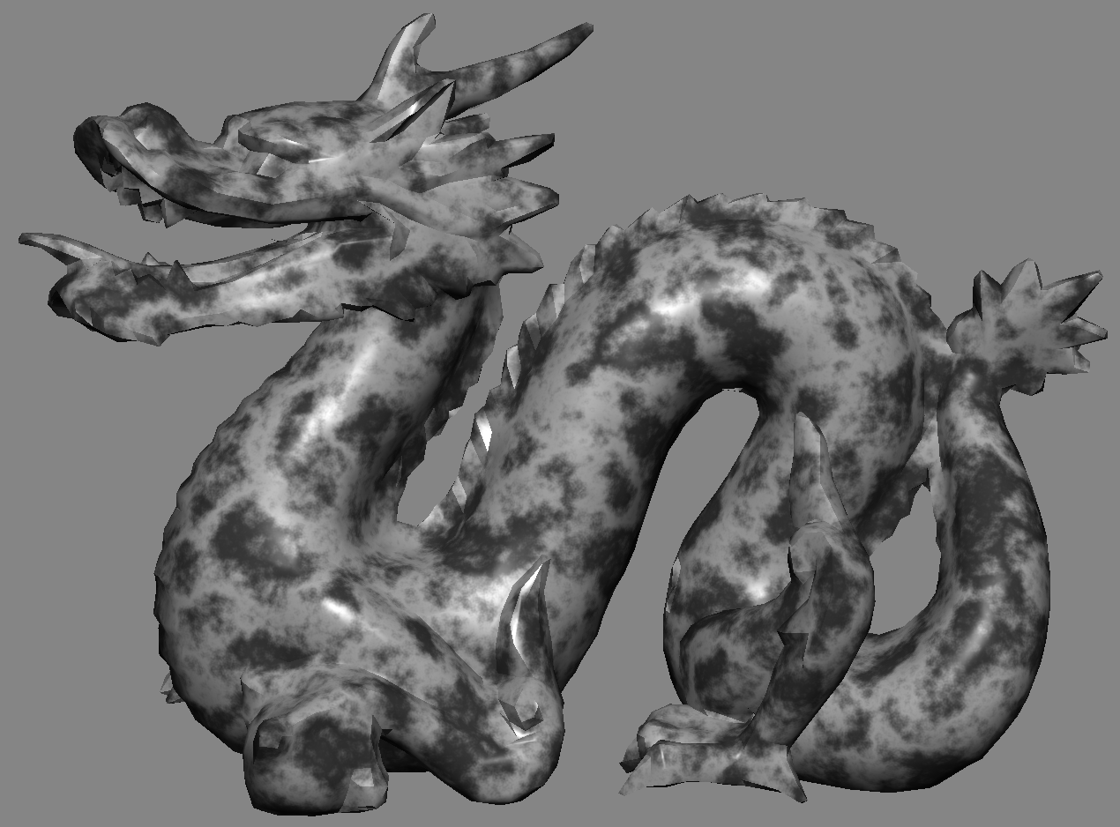
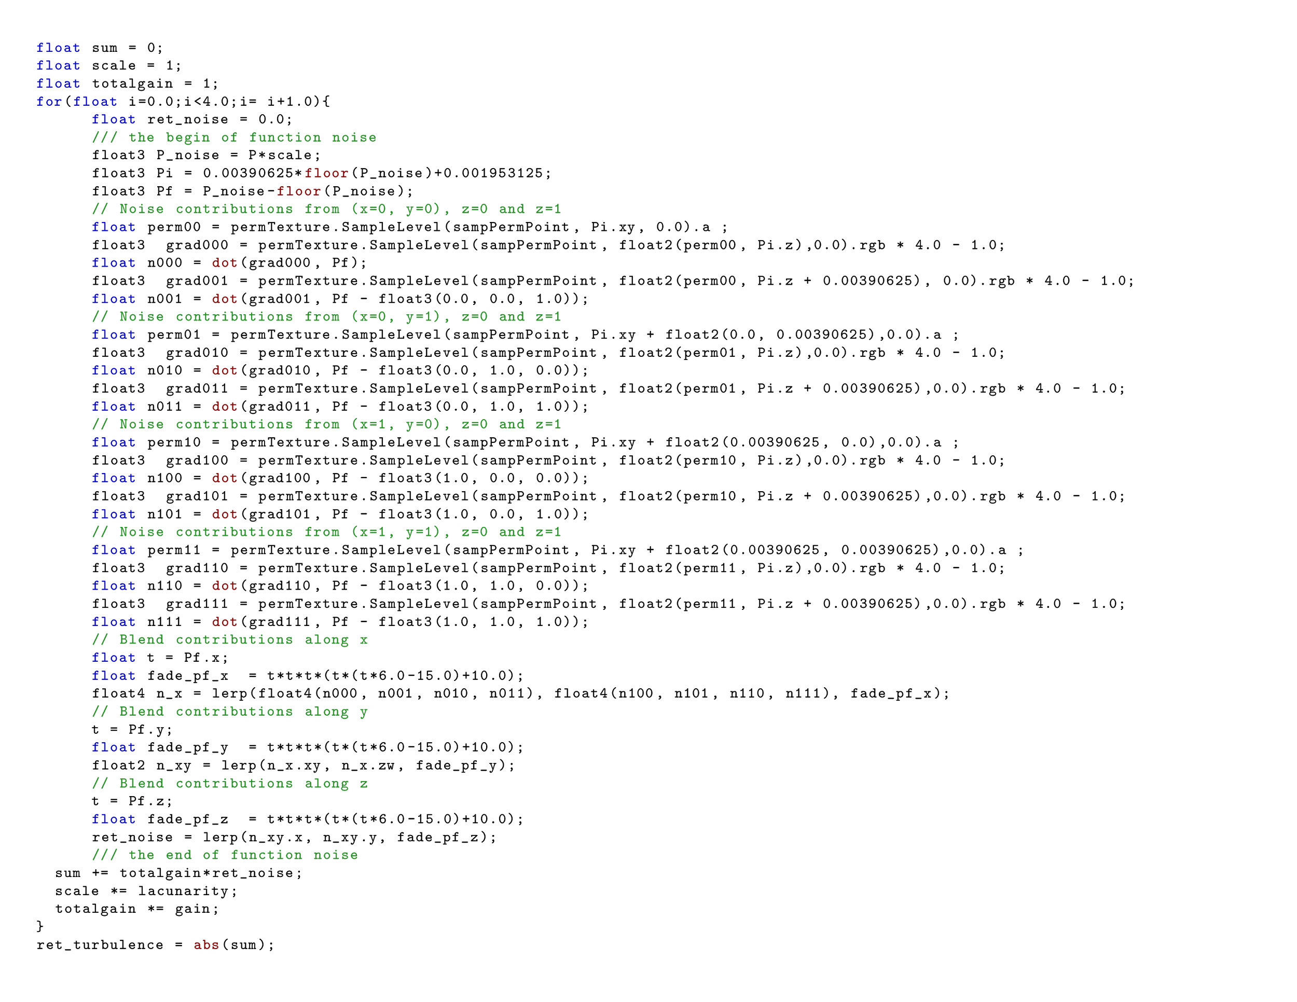

Slide 23
Approximate a single triangle

Slide 24
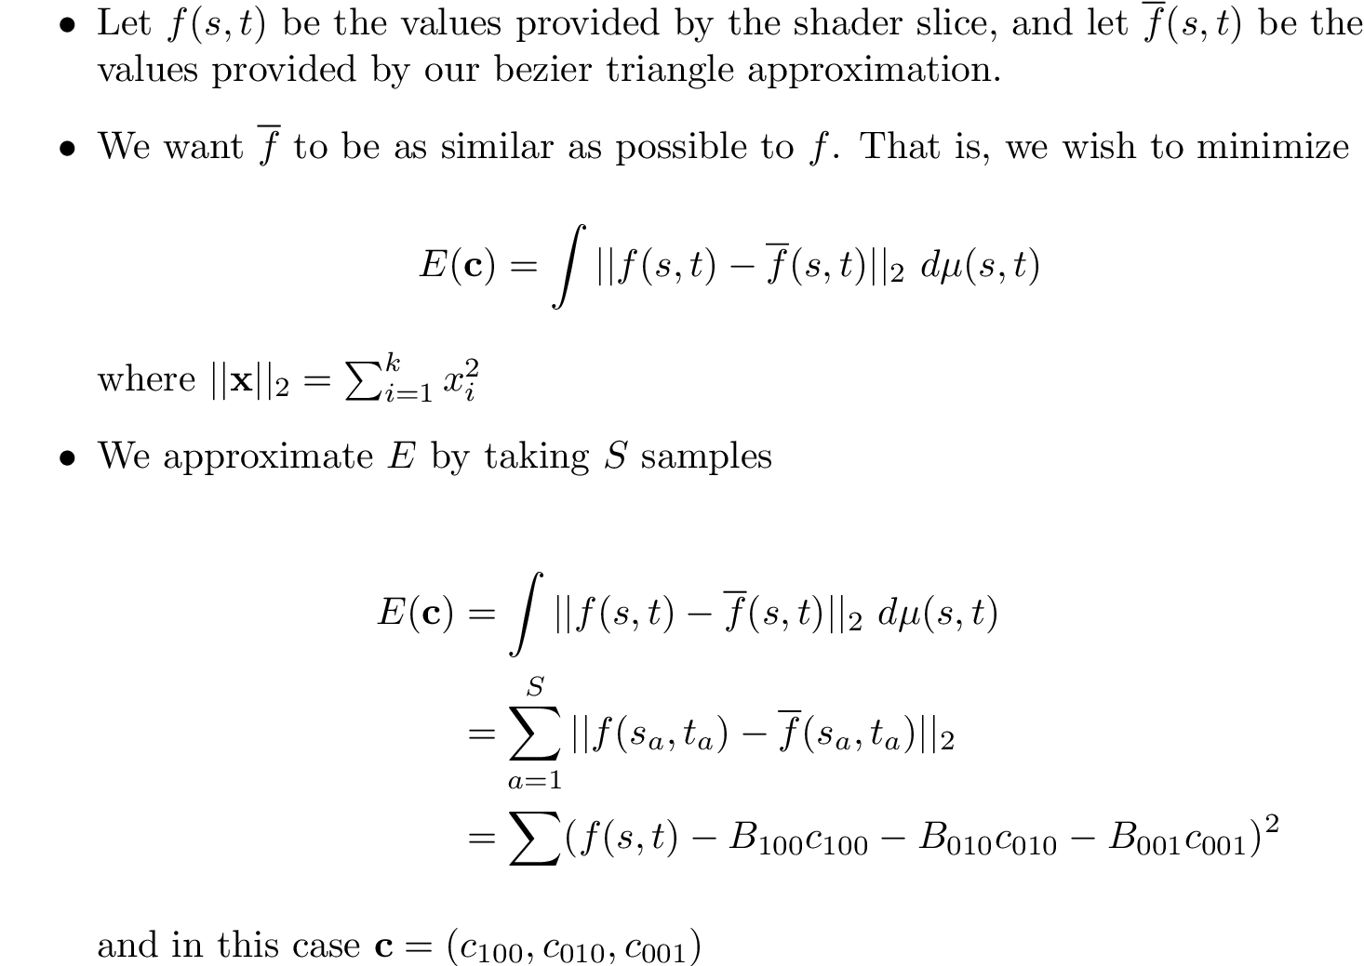

Slide 25
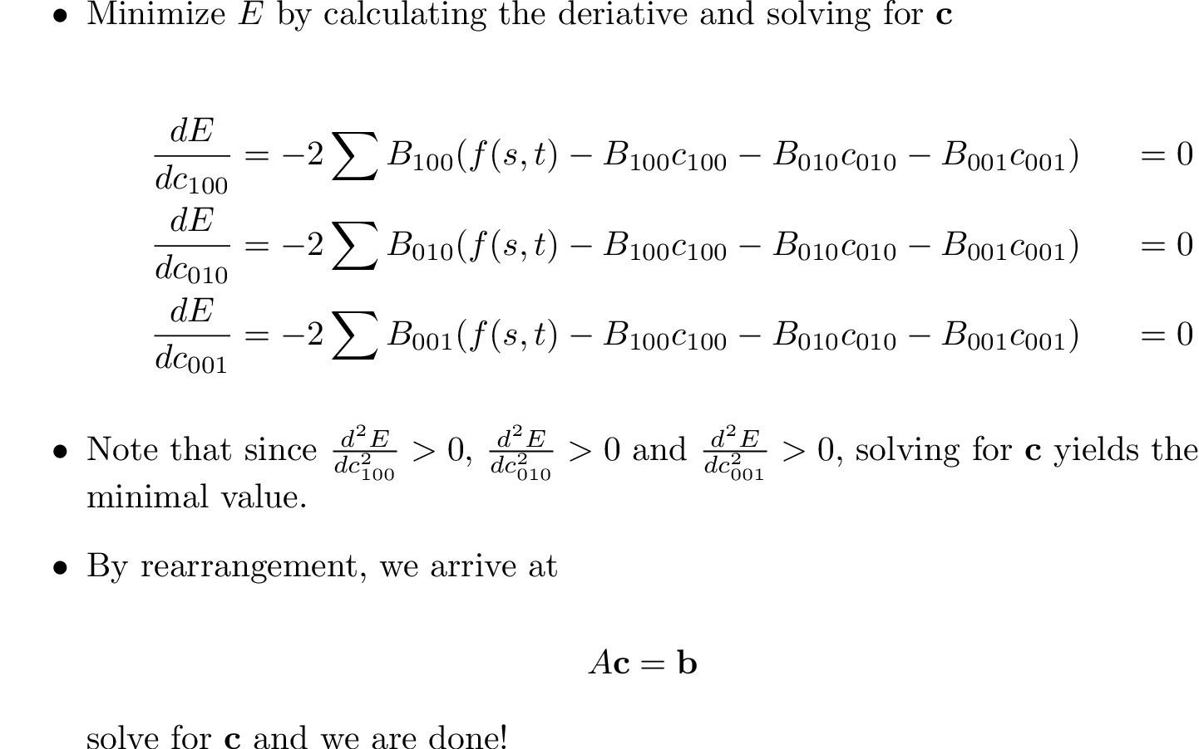

Slide 26
1:st order bezier triangle approximation
Approx

Slide 27
2:nd order bezier triangle approximation
Approx

Slide 28
4:th order bezier triangle approximation
Approx

Slide 29
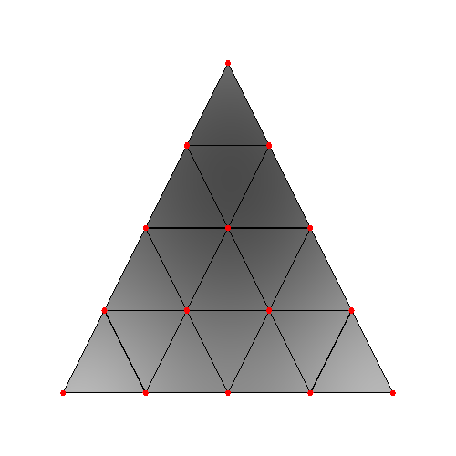
4:th order bezier triangle approximation
Approx

Slide 30
global approximation

Slide 31
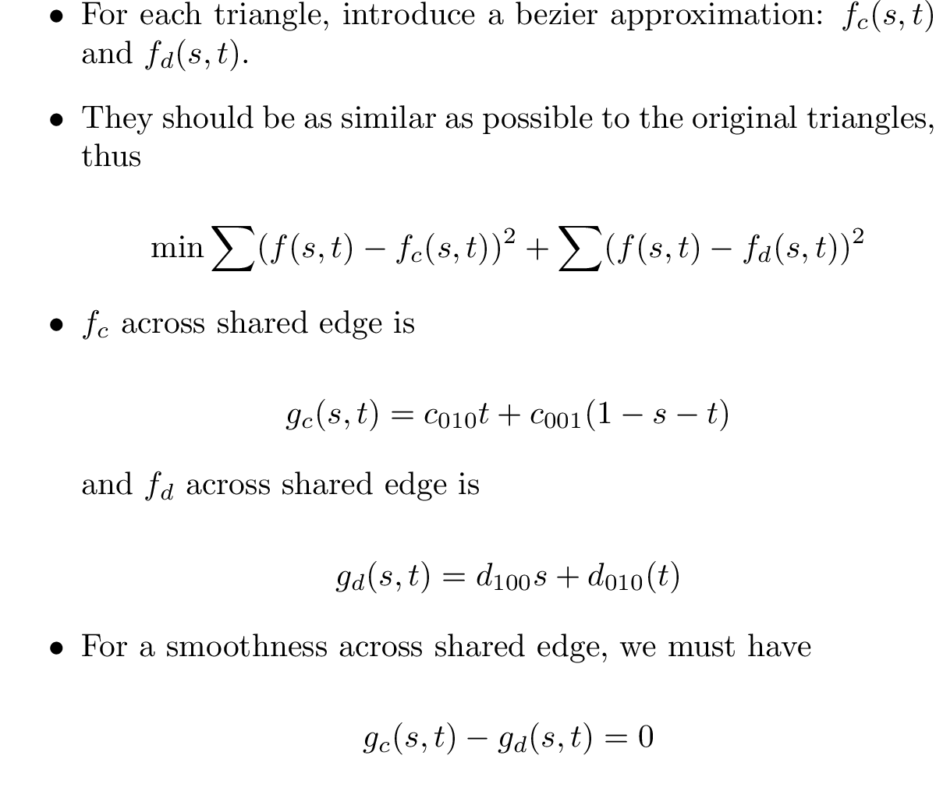
Globally solving
d₀₀₁
d₀₀₁
c₀₀₁
D
C
d₁₀₀
c₀₁₀
c₁₀₀

Slide 32
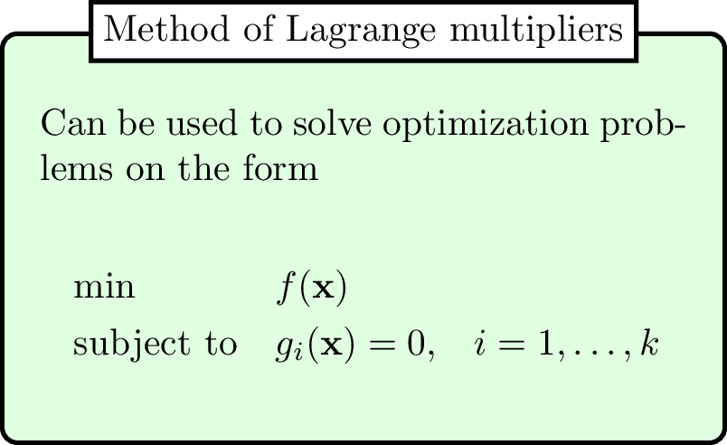
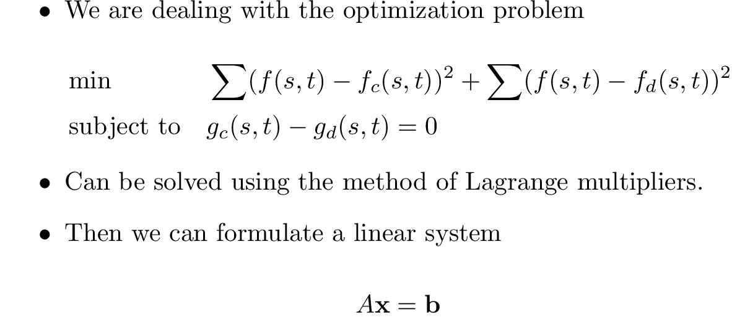
Lagrange to the Rescue!

Slide 33
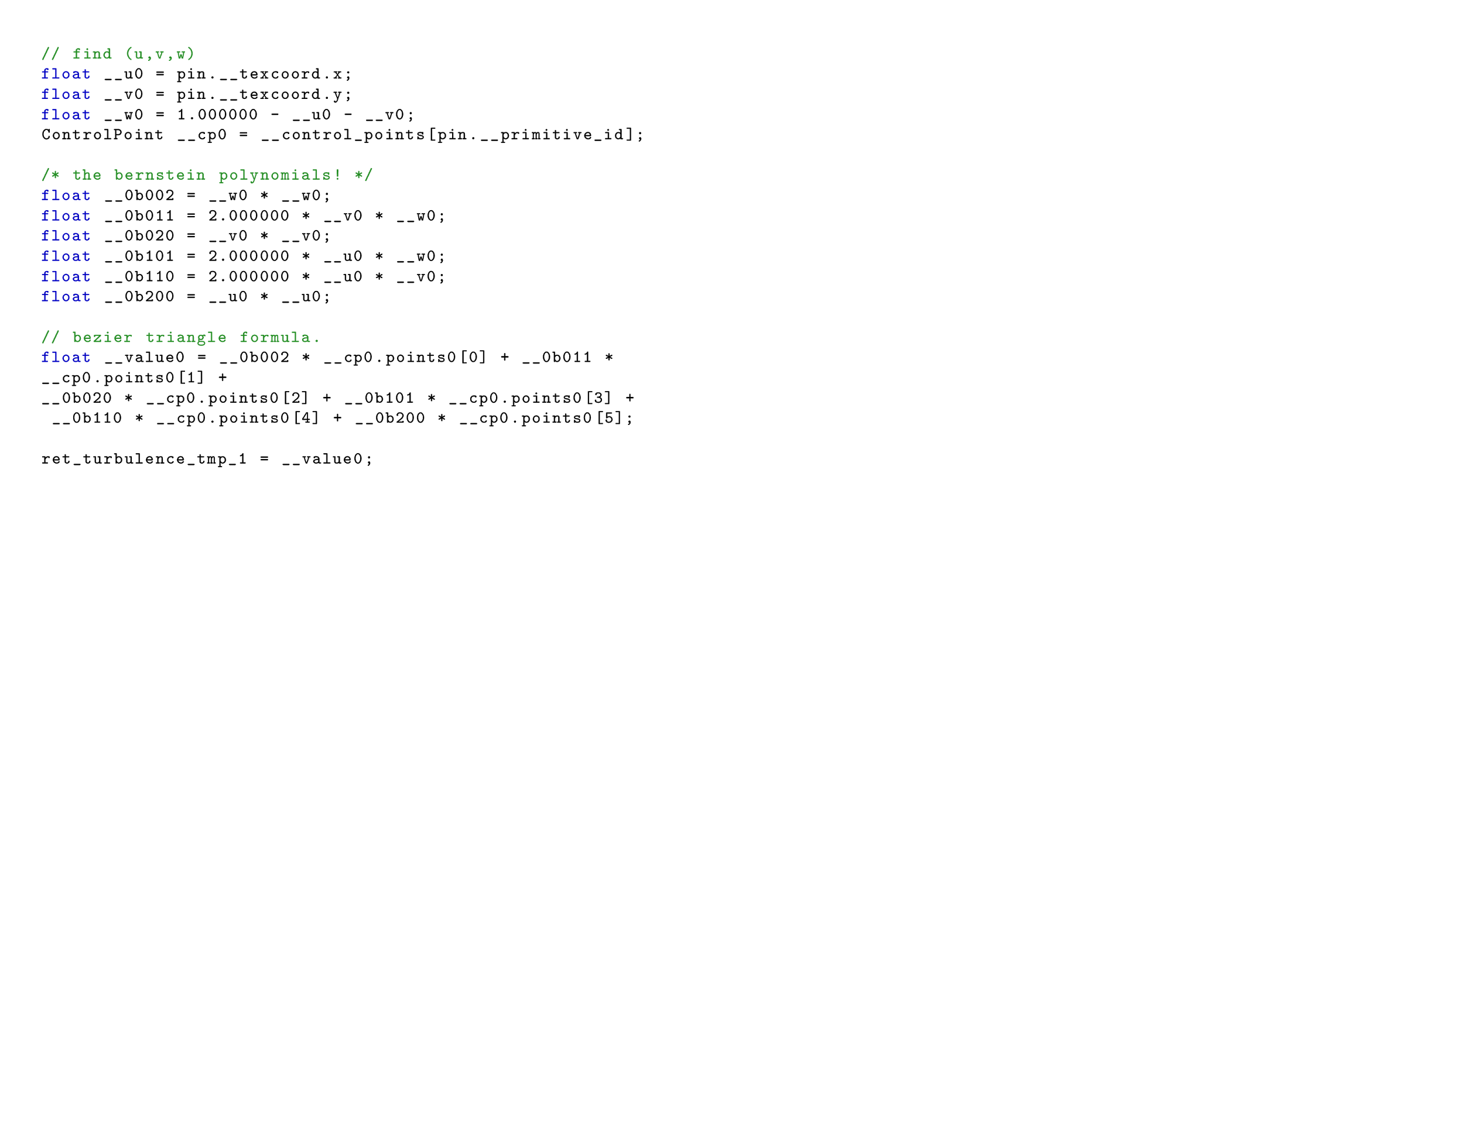
Before and after

Slide 34
Rule 2 and 3
We can tesselate, then fit bezier triangles.

Slide 35
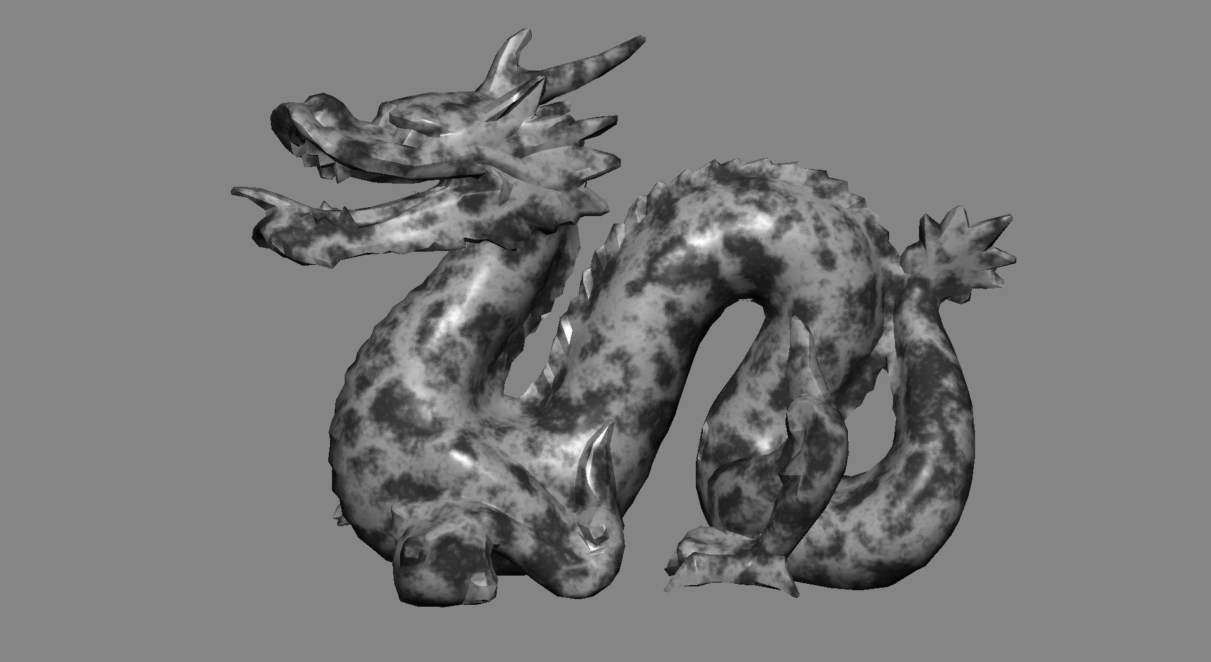
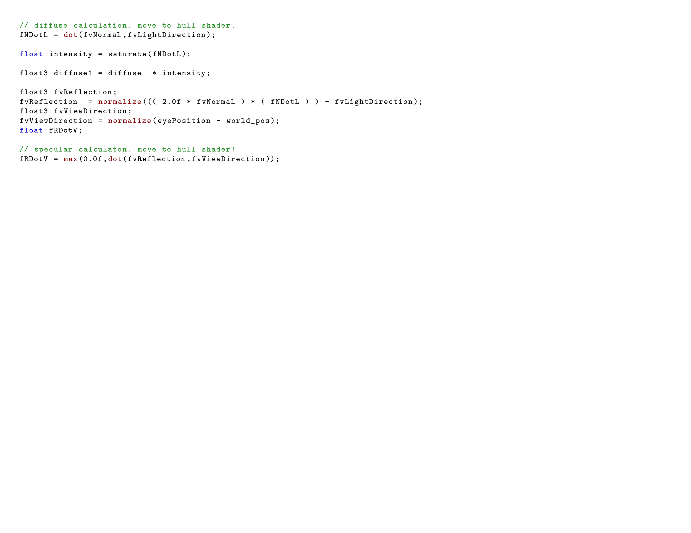
An example
Two-level triangle subdivision
Approx perlin by 2nd order bezier triangle
Move part of lighting to domain shader

Slide 38
Genetic algorithm
Given a fitness function f(x)
And an initial population
Generate an individual with maximum fitness
f(x)

Slide 39
Initial population
Randomly create an initial population
High-fitness individuals have a high probability of getting to mate

Slide 40
Crossover operator
Mate, and produce a new individual by combining bits.
0101 0111
Crossover
0101 0111
0101 0111

Slide 41
Mutation operator
With low probability, randomly flip bits when creating offspring
Usually produces low-fitness, good-for-nothing individuals
But helps maintain genetic diversity and prevents getting stuck at local maximas.
Mutation
0101 0111
0100 0110

Slide 42
The next generation
Mutated individual ended up at global maxima!

Slide 43
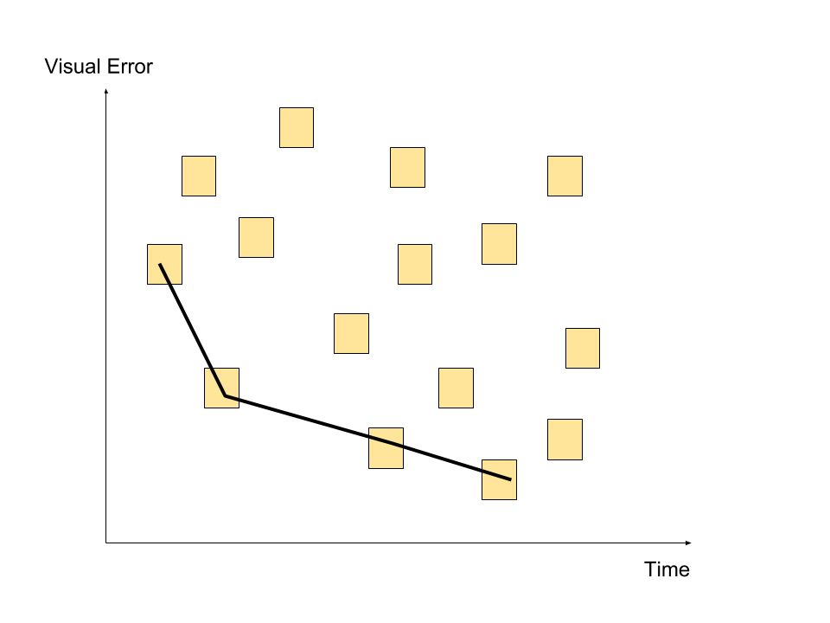
Paredo frontier

Slide 44
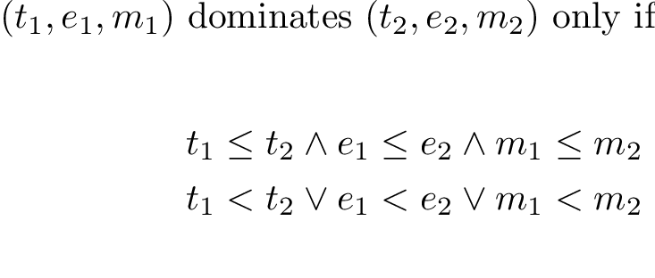
The Algorithm
The fitness f(x) function takes a shader variant x, and yields a triple (t,e,m), where t is the computation time, e is the visual error, and m is the memory consumption.
Mutation operator: change simplification rules applied to shader slices.
Example: {move (x,n=11) to domain shader } is mutated to {approximate (x,n=11) by 2nd order bezier triangle}

Slide 45
Algorithm
Crossover operator: Exchange shader slices for two variants.
Example: from {tess_level=3, (x,n=11) to domain shader} and {tess_level=2, approximate (x,n=11) by bezier triangle of degree 2} we create the offspring {tess_level=3,approximate (x,n=11) by bezier triangle of degree 2 }
Then in the final iteration, take all variants lying in the pareto surface.

Slide 46
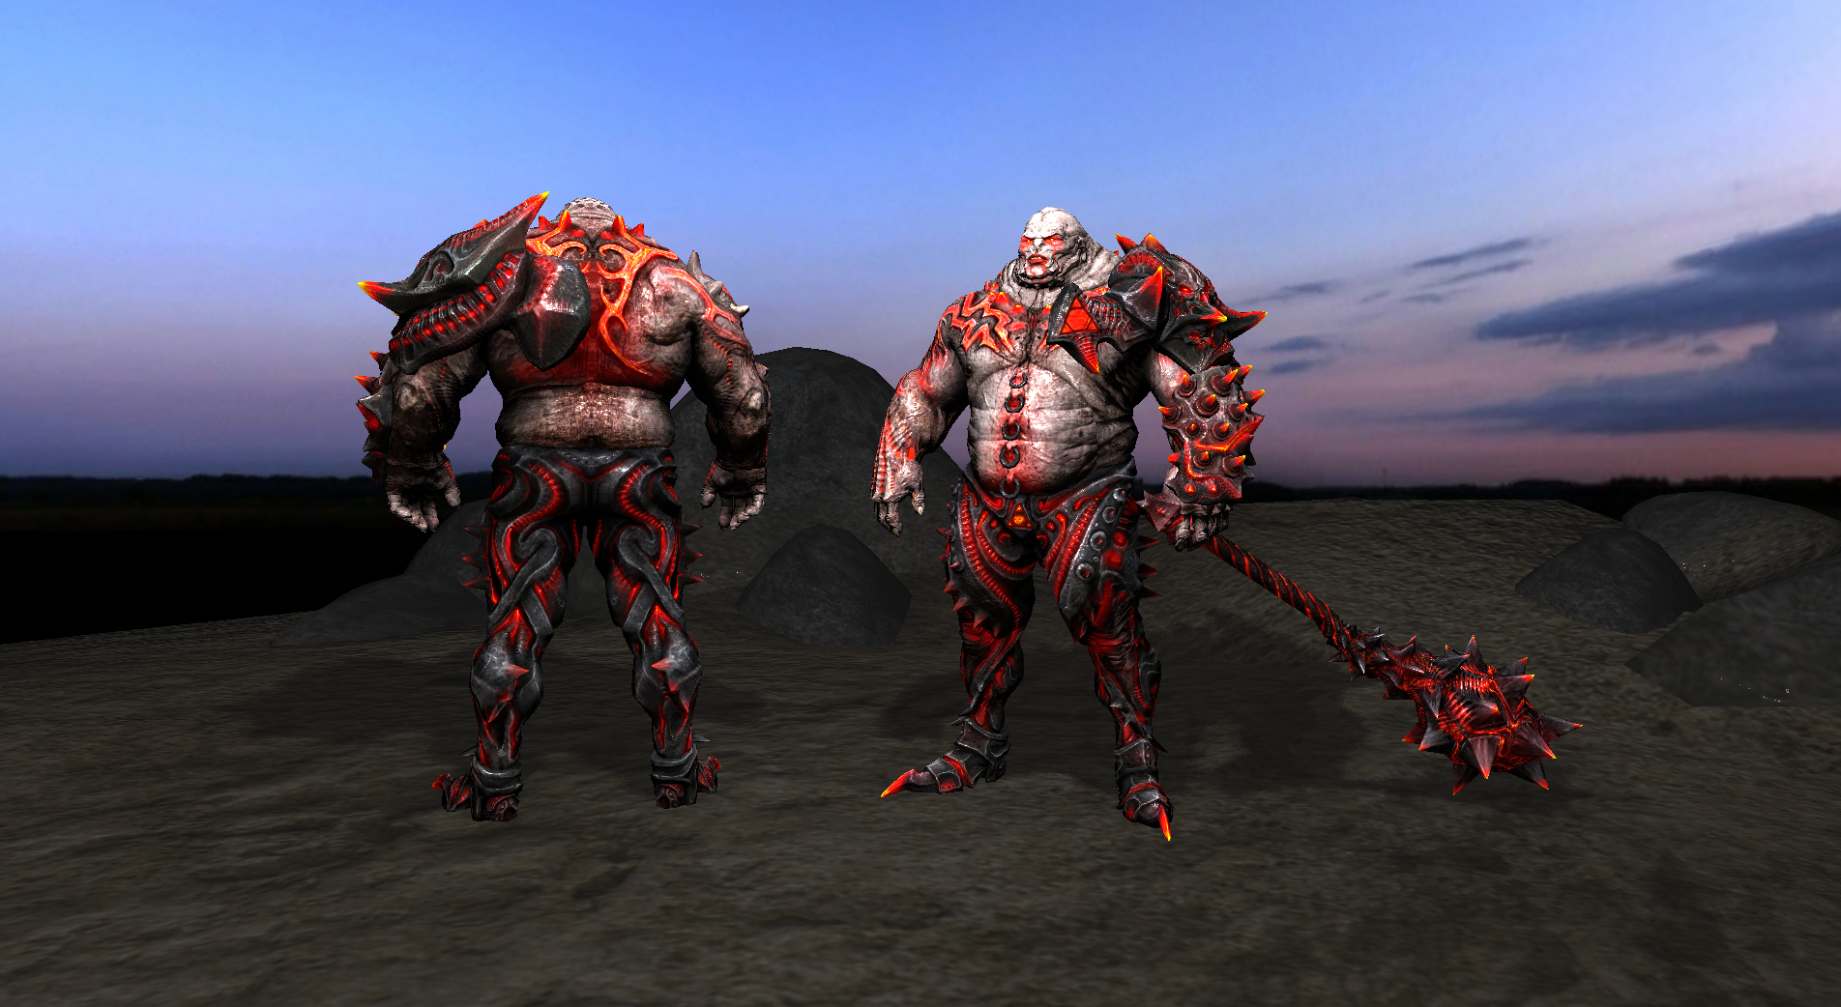

Slide 47
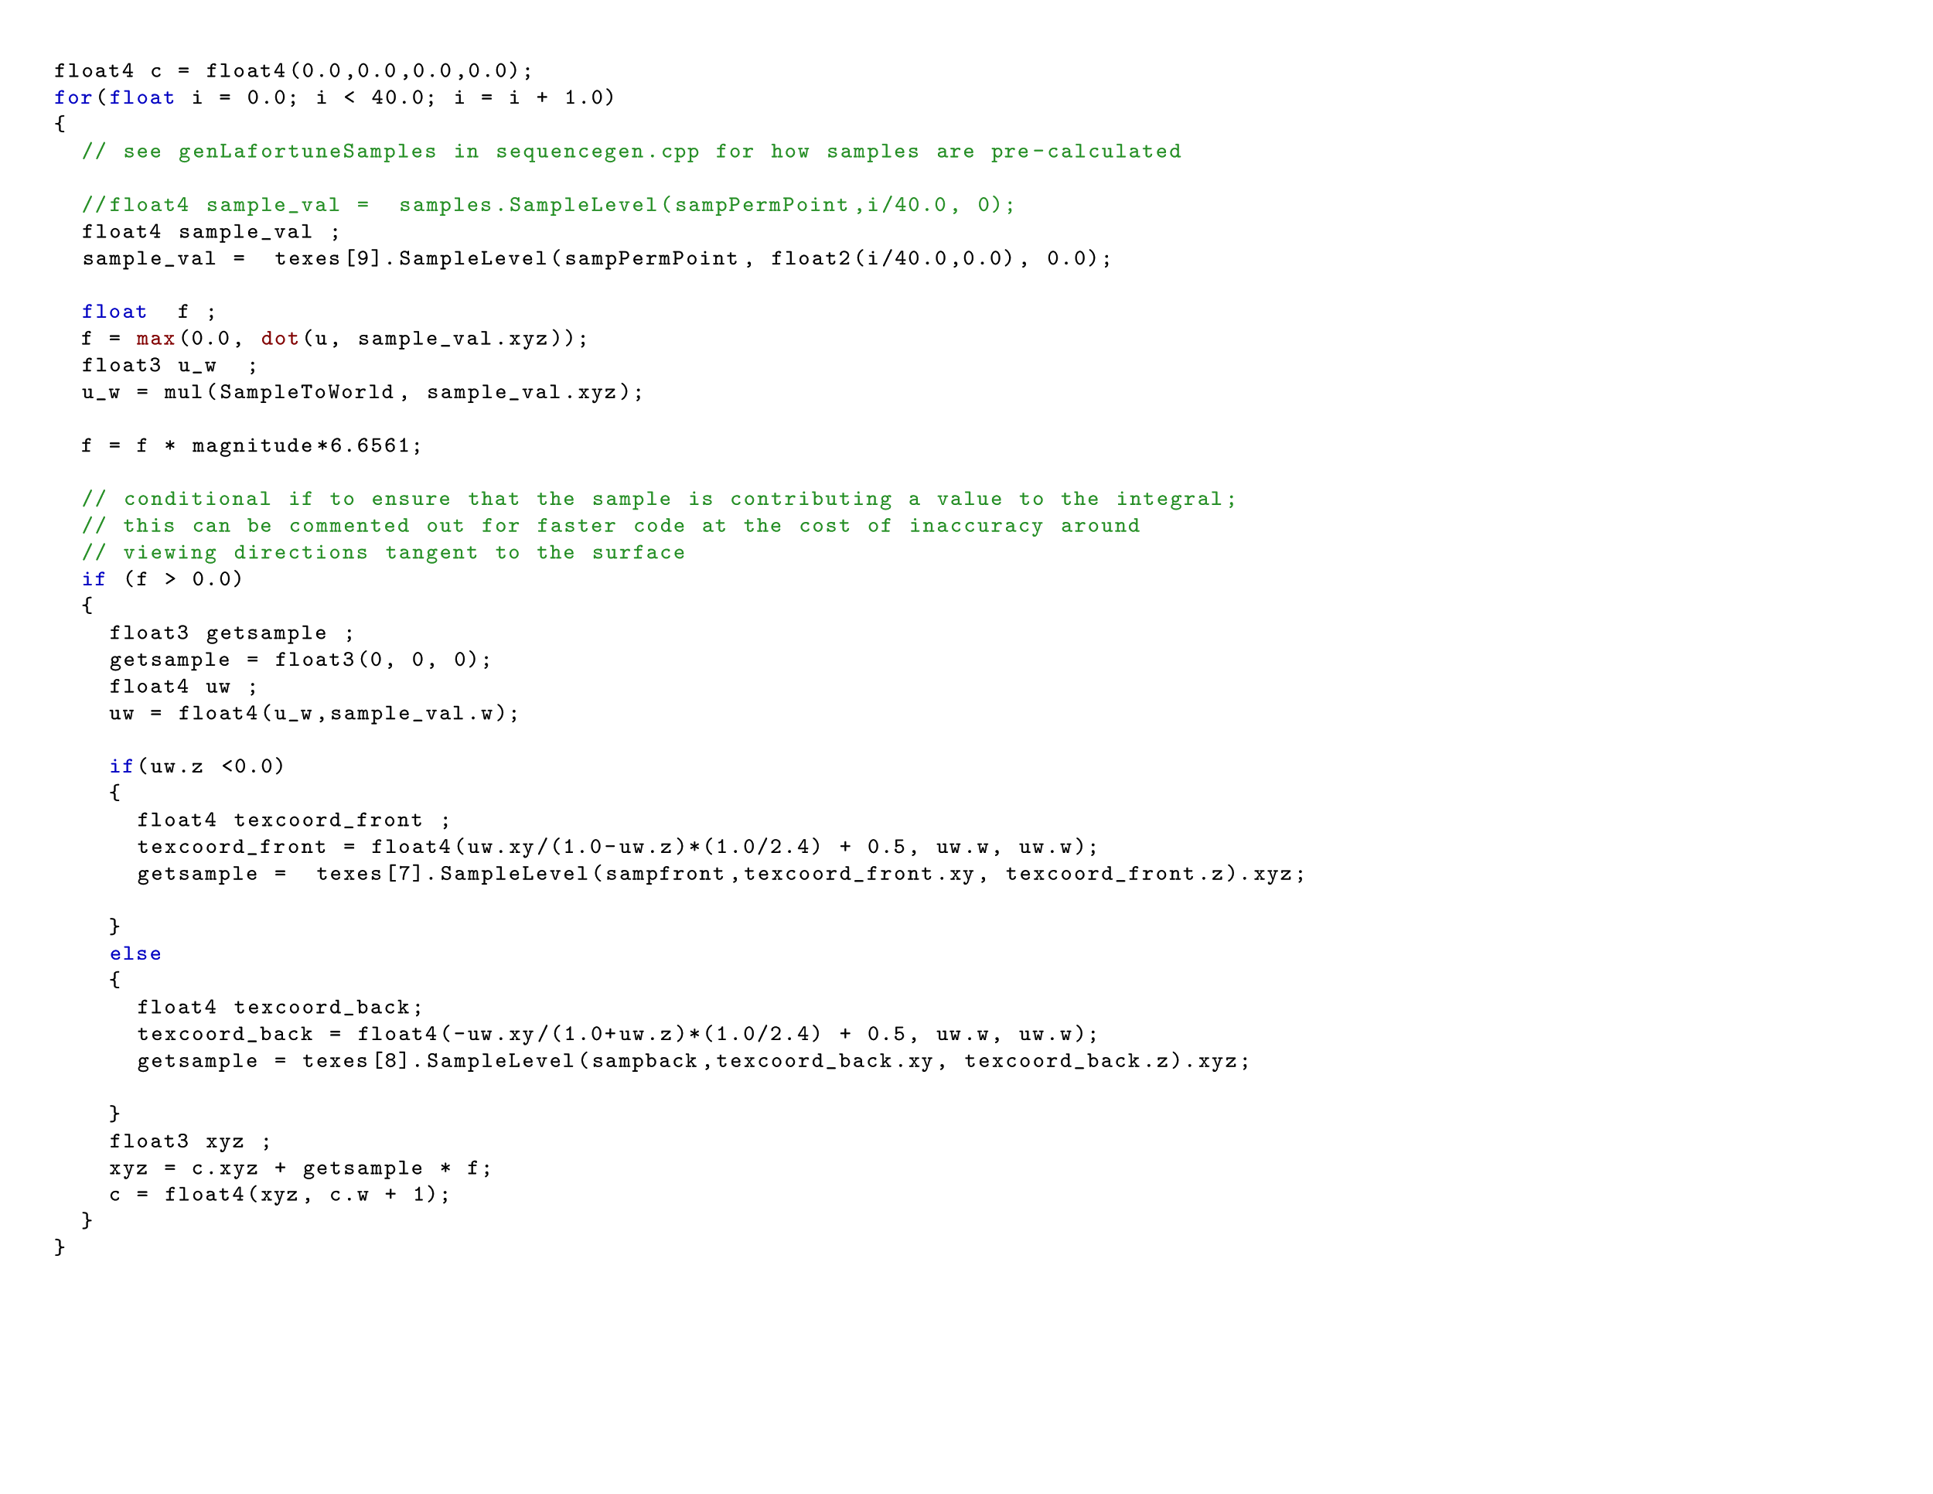
Imrod shader
Complex, long fragment shader
Diffuse, specular, normal, emissive, and ambient occlusion map
Environment lighting and one point light
GPU importance

Slide 48
First simplified shader
Move 37 iterations from fragment to vertex shader
In vertex shader: for (float i = 0.000000; i < 36.000000; i = i + 1.000000)
In fragment shsder: for (float i = 36.000000; i < 40.000000; i = i + 1.000000)

Slide 51
Results
2x speedup(!)
minimal visual errror

Slide 52
Second simplified shader
Move texture fetch of AO map from fragment to vertex shader
AO is low frequency, so should make little difference.
Approximate importance sampling by bezier triangles

Slide 55
Results
Almost 4x speedup(!!)
Visual error still minimal
Uses 0.21mb more memory.

Slide 56
Third simplified shader
Move normal map texture fetch to vertex shader
Move part of specular shading involving normal map to vertex shader
Compute environment lighting at vertices

Slide 58
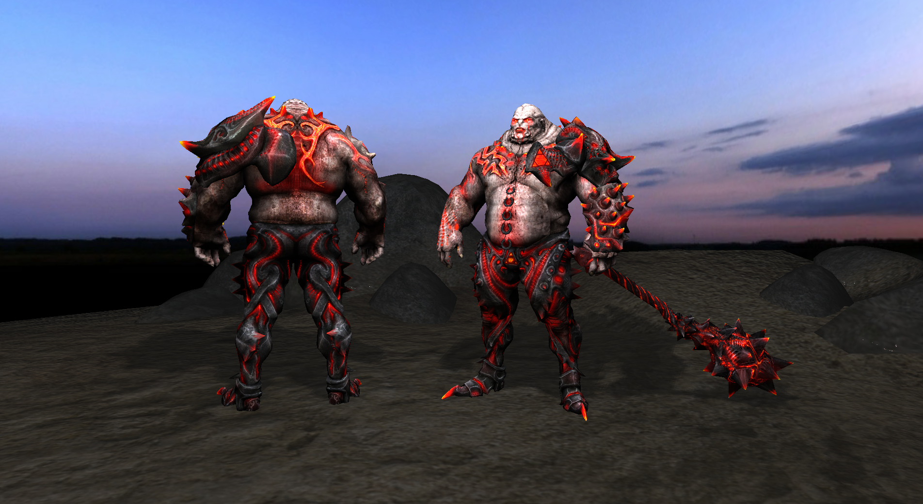

Slide 59
Results
Smoothens out the lighting
Slower than 2nd simplified shader
But uses less memory than 2nd shader
Probably slower because it precomputes less

Slide 60
Discussion
This method deals well with approximating low frequency detail, but not very good when approximating high frequency detail

Slide 61
Frequency analysis
Using fourier analysis, we can consider images a sum of sine and cosine waves
We extract these using a fourier transform.

Slide 62
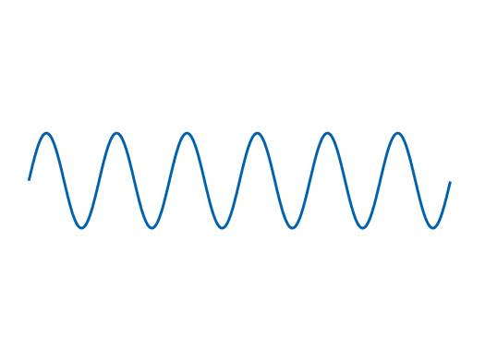
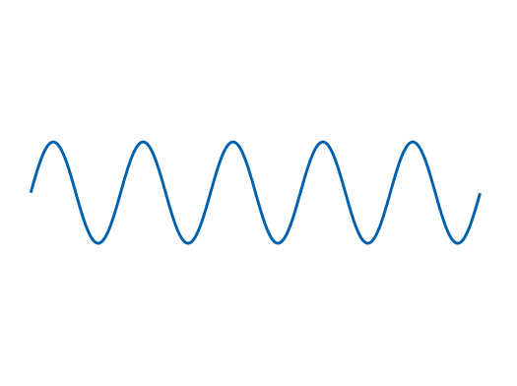
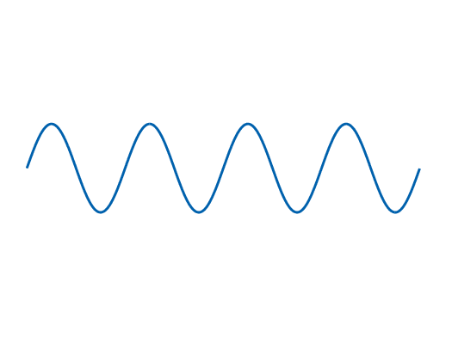
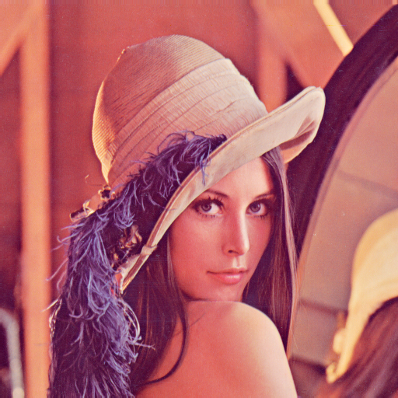
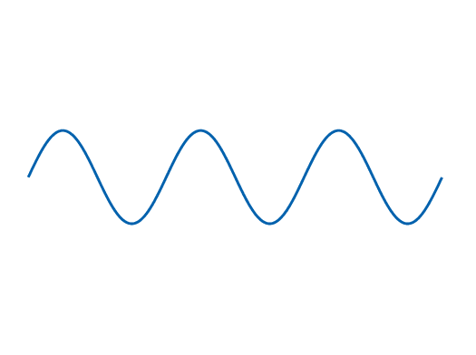
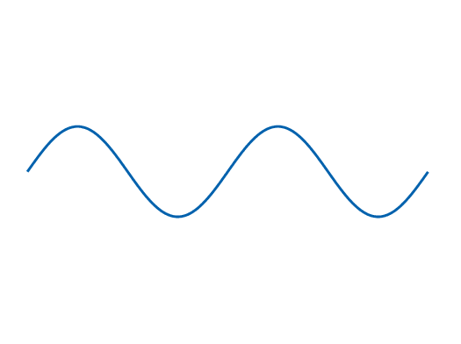
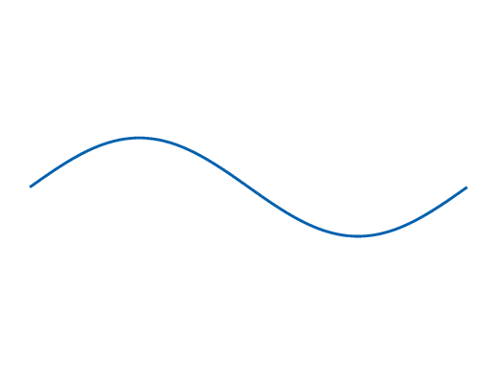
Frequency analysis
High freq
=
+
Low
freq
Notes:
26,1 gaussian
1.5 high pass

Slide 63
Cloud
High freq
=
+
Low
freq

Slide 64
approx:
original:

Slide 65
approx:
original:

Slide 66
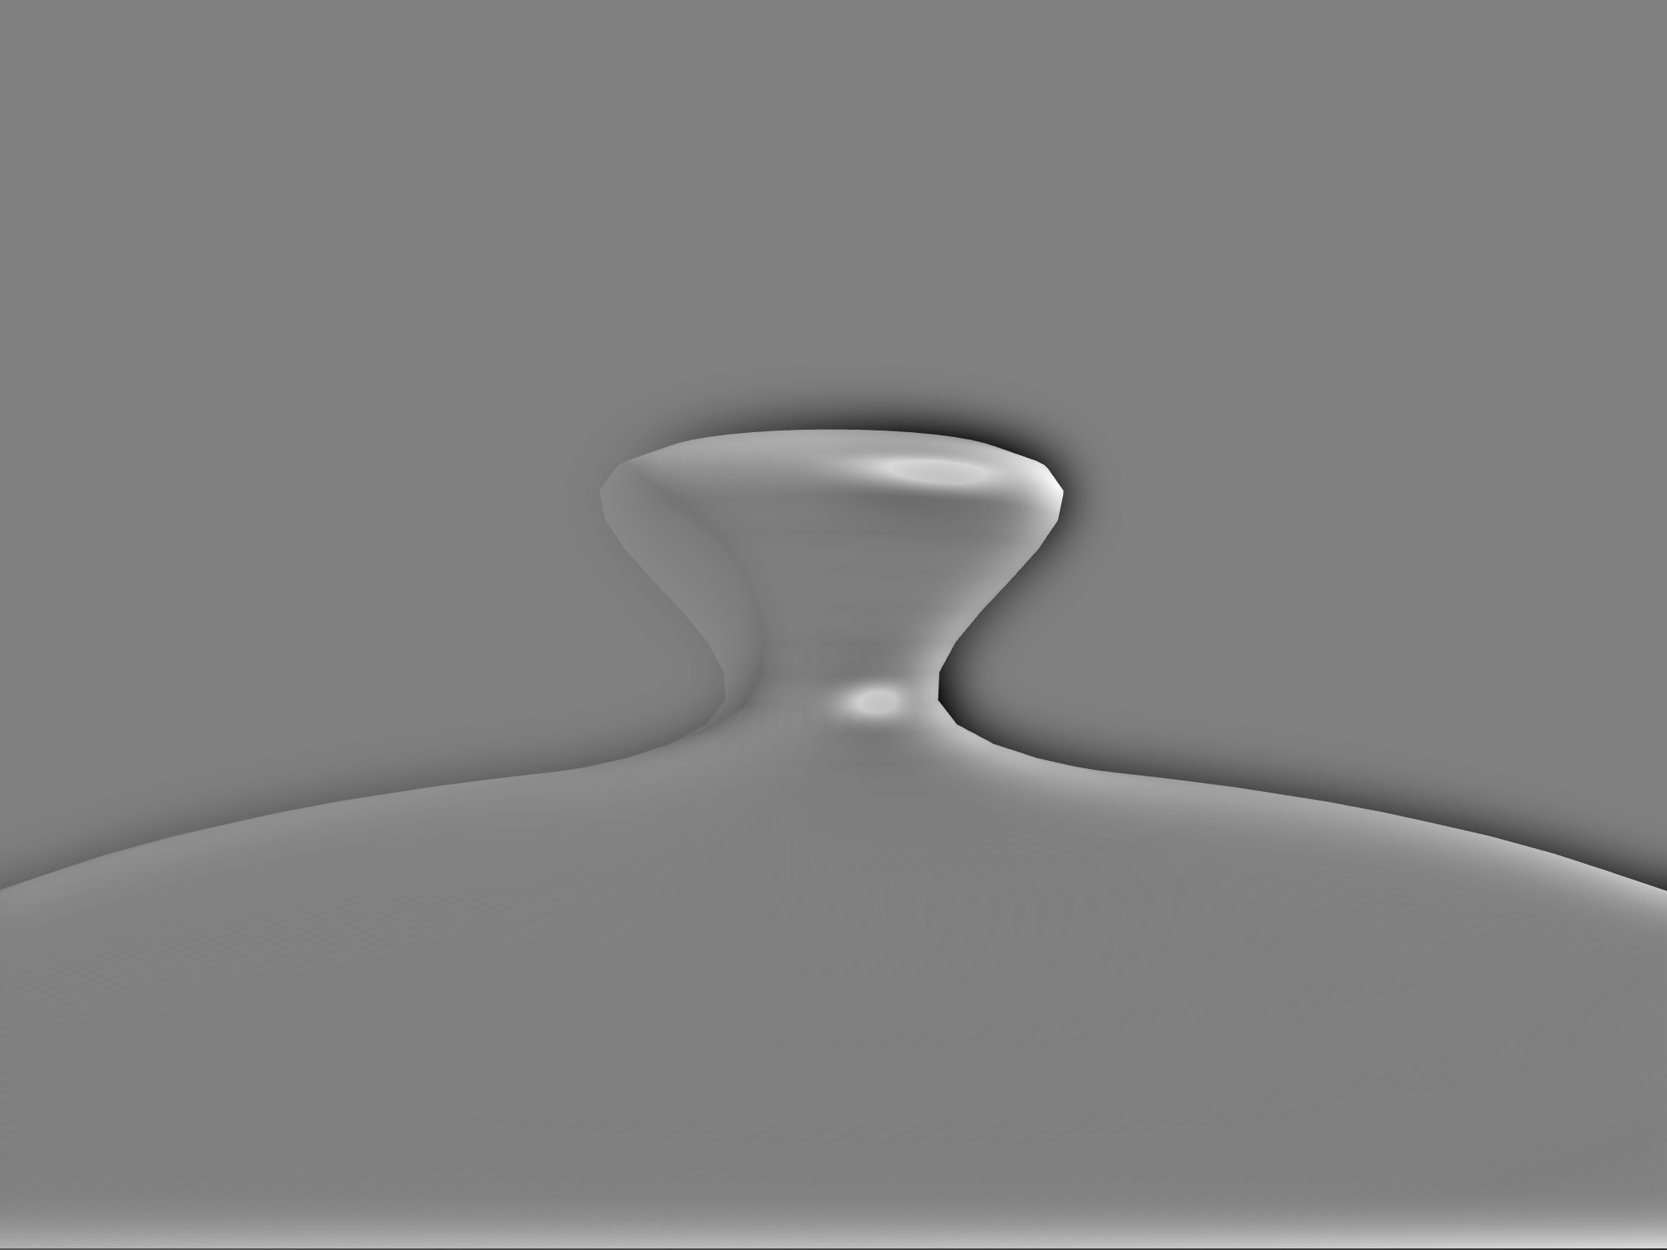
teapot
=
+

Slide 67
Discussion
It is completely wasteful to calculate low frequency signals in fragment shader.
Bezier triangles or vertex interpolation approximates such signals just fine

Slide 68
Possible future work
Use frequency analysis to prove even better appromations.

Slide 69
Possible future work
Add more simplification rules.
[Pellacini 2005] proposed a rule
[Wong et al] combined with this rule results in a speedup in exchange for a slight visual error.
e ⊗ c → e

Slide 70
Questions?

Slide 71
http://caig.cs.nctu.edu.tw/course/NM07S/slides/chap3_3.pdf
http://www.scratchapixel.com/lessons/3d-basic-rendering/ray-tracing-rendering-a-triangle/barycentric-coordinates

Slide 72
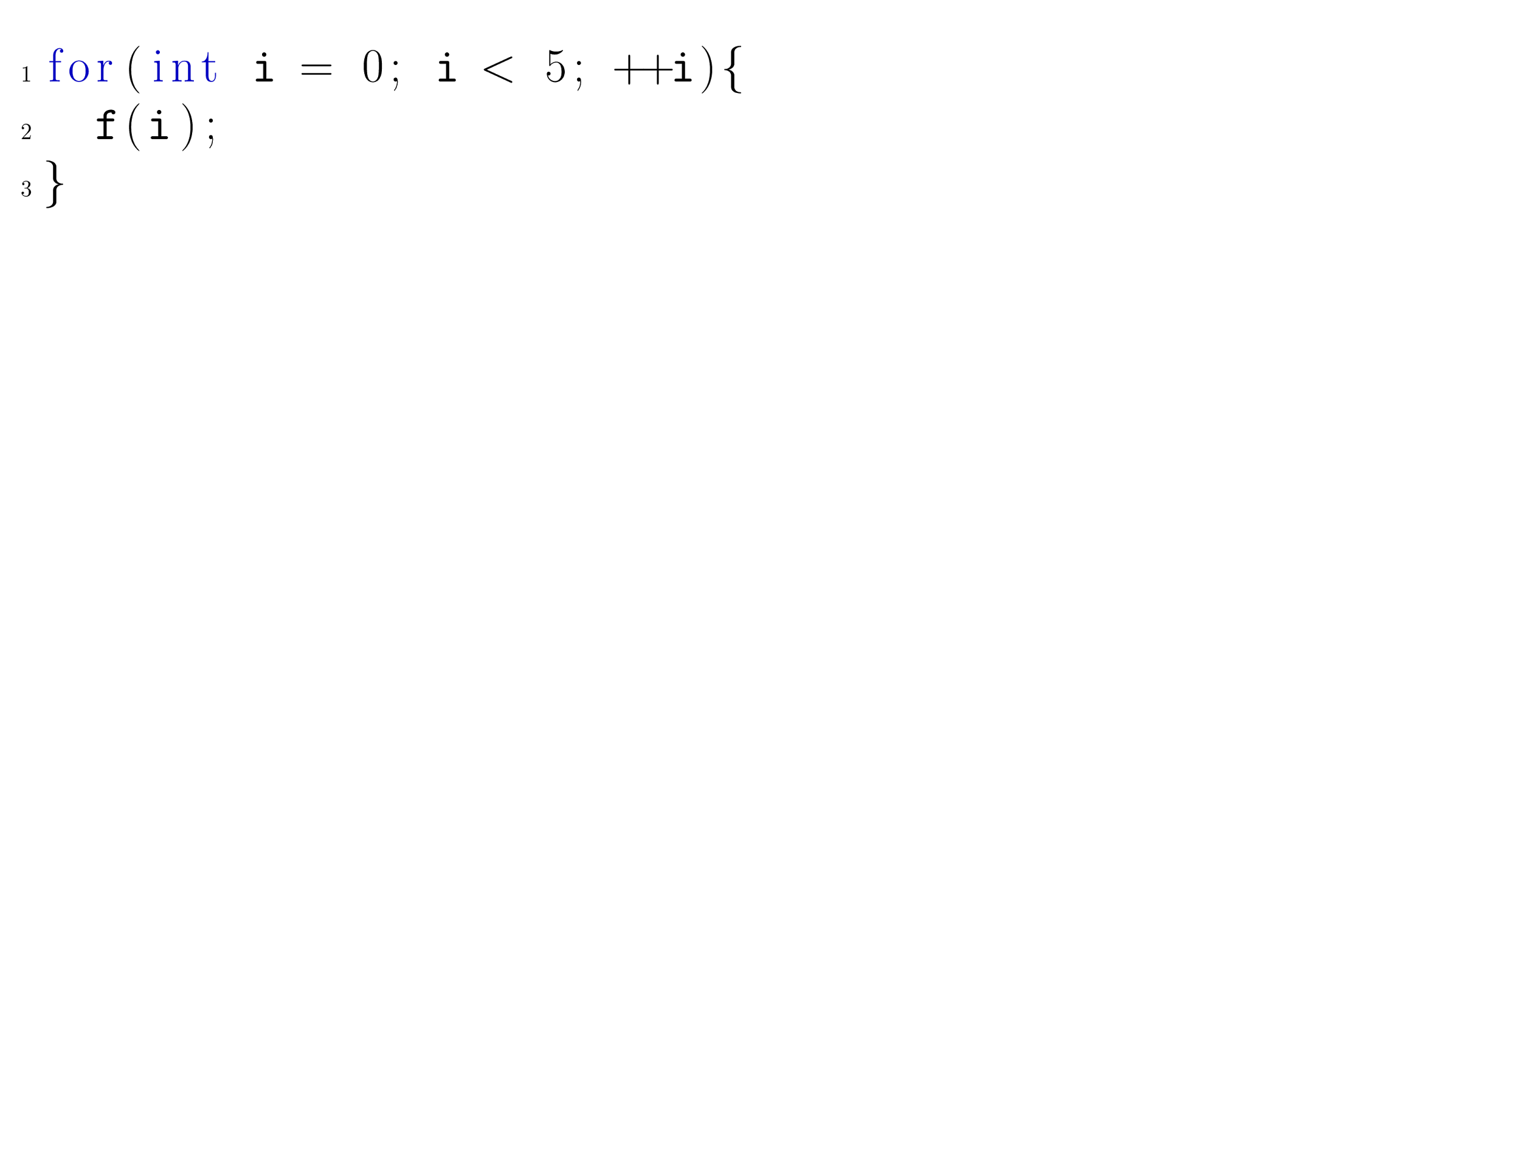
Shader Slice Loop
Notes:
Note that for loops we define shader slices in a special way. We unroll the loop, and consider every separate iteration a shader slice.
As we will see later, it is important that we define it this way.

Slide 73
Structure
A couple of rules to simplify the shader
Rule 1: move fragment shader code to a previous shader stage.
Rule 2: approximate patterns formed by shader with bezier triangle interpolation.
Rule 3: Tesselate mesh with tesselation shader, then apply rule 1 or 2.
Genetic algorithm
Discussion
Future work
Notes:
A system that rewrites shader such that they performance greatly improves, while still retaining their visual appearance.
First I will be going through the algorithm, which will occupy a majority of the time.
Next, I will discuss the pros and cons of this algorithm, and compare it with othe approaches.

